Slide 1
NSM
Incident Response

Slide 2
Network Traffic
Before we get to NSM we need to talk about network traffic
What it looks like
How it behaves
”Normal”
Wireshark is one of our primary tools that we’ll use
Network Security Monitoring
Data we need for finding malicious events

Slide 3
Wireshark
Packet & protocol analyzer
Great tool for inspecting network traffic
Doesn’t scale particularly well, but best for learning
You may have used it before, but if you haven’t that’s fine
Rare: Works well cross platform
Packet Sniffer
Works ok, not great
Uses the libpcap library
Allows us to filter

Slide 4
Where to use it
Troubleshooting
Troubleshooting
Troubleshooting
Why something behaves the way it does
Is traffic moving the way we think it is?
Whether this is to check if we’re getting traffic at all or if parts of the packet are getting formed the way we think they’re getting formed
Ping example
Learning!

Slide 5
Wireshark Capturing
Not great for long term capturing
It captures all data as a frame
Hopefully it knows how to correctly decode the data
It knows about a bunch of different protocols
Sometimes it doesn’t
Do we want to capture in promiscuous mode?
Does this let us see everything?
Do we want to see everything?
Wifi?

Slide 6
Where things are captured

Slide 7
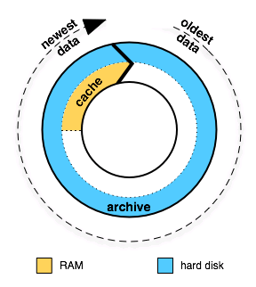
Capture Buffer

Slide 8
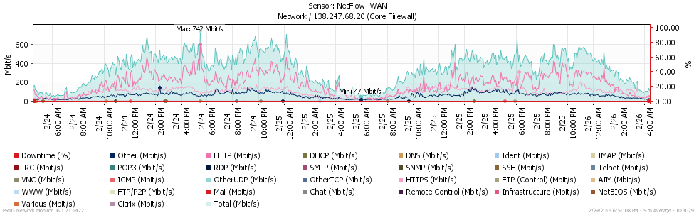
Bigger Network Interfaces
Notes:
A lot of NICs can handle a lot of traffic
Dropping frames can confuse traffic
Handling buffers is very important

Slide 9
Speeding up Wireshark
Increase the buffer size
Don’t do dynamic screen updates
Don’t resolve names
Get a better computer
Stop other things that are running

Slide 10
Capture Filters
Allow you to limit what is being captured
Does this help or hurt our ability to capture more data without dropping packets?
host 10.1.1.1
host 192.168.0.1 and host 10.1.1.1
tcp port http
ip
not broadcast not multicast
ether host 00:04:13:00:09:a3

Slide 11
Capture vs Display Filter
Capture filter just limits what’s captured
Helpful, but not that helpful
Display filters
Completely different format

Slide 12
Cautions of Wireshark
Reading bug logs, you’ll see security fixes
Isn’t the best “enterprise” capture tool
Again, good for troubleshooting
Don’t run as administrator
Especially opening outside files

Slide 13
Theory of NSM
Typically
Log blocked network traffic
Allow other things to flow freely
Backwards
Why?
Where does NSM not work?
Large volumes of data
Encrypted data
Privacy???

Slide 14
Types of Data to look at in NSM
Full content
Everything
Extracted content
Files
Session
Who is talking to who
Transaction
Who is saying what
Statistics
Common occurrence vs this never happens
Metadata
Data about data
Alerts

Slide 15
Challenges with NSM
So why do we even need it?
It can be expensive
Very time consuming
It doesn’t actually prevent anything
We have IPS for that
Prevention isn’t that great
Firewall prevents, IDS detect

Slide 16
4 Rules to Realize
All of our current “systems have flaws that make them vulnerable
We can’t replace the “systems” we’re using right now
We can’t make a perfect ”system”
Even the perfect “system” can be compromised by an insider, willingly or not
No, it doesn’t always have to be on purpose

Slide 17
NSM’s Value
Post—occurrence value
If we’re 100% secure, NSM is useless
Everyone thinks they are 100% secure, nobody is
NSM: Detect bad things
NSM: Reproduce attackers traces
NSM: What did they do?
What did they steal?
How bad is it?
This informs the rest of the steps as you’re responding

Slide 18
Summary
NSM is essential, but often overlooked
Because it doesn’t ”prevent”
Typical security measures are ineffective
Defensive security only goes so far
Remember back to planning when I said we do defensive security to reduce attacks?
We don’t eliminate them
We need the ability to reconstruct events
Network forensics/heuristics

Slide 19
Wireshark demo And a lab too

